Slide 1


Prophylactic Bilateral Salpingectomy for Risk Reduction Of Ovarian/Fallopian Tube/Peritoneal/ Breast Cancer
Muhammad M Al Hennawy
First Consultant Obstetrician and Gynecologist
Ras El Bar Central Hospital ,
Dumyat Specialised Hospital ,
Egypt
01222503011
mmhennawy.site44.com

Slide 2
Ovarian cancer is the leading cause of death due to gynecologic malignancy and
The fifth most common cause of cancer deaths in developed countries

Slide 3
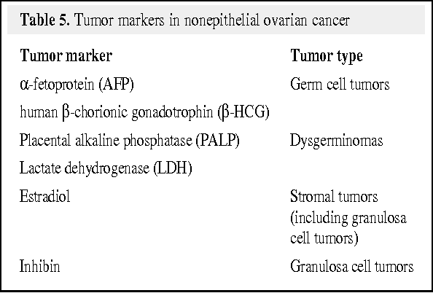
In both general population and high-risk women,
Screening (TVUS and Ca-125) for ovarian cancer is not recommended,
As no mortality benefit has been demonstrated even with strict adherence to screening protocols

Slide 4
Unlike breast and cervical cancers, there is no supported standard screening method to detect preinvasive or early ovarian cancer. The result is 70% of women present with late-stage III and IV disease and poor prognoses

Slide 5
Symptoms of ovarian cancer are non-specific
Often do not arise until the cancer is in a late stage, the point at which the majority of women are diagnosed

Slide 6
Five-year overall survival is less than 50 %
It has not substantially changed in the last two decades

Slide 7
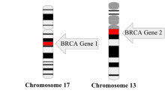
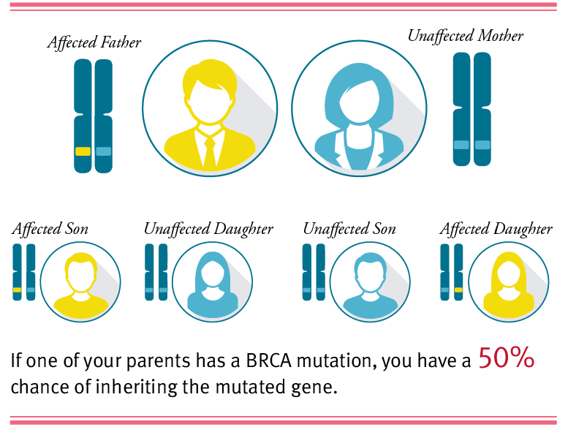

Risk factors
1- Age.
2-Family history
3-Ethnicity: >white women <black women &Asian
4- Diet
5-INHERETED GENE MUTATIONS.
- (BRCA1) & (BRCA2). 5 percent to 10 percent of ovarian cancers inherited syndrome called hereditary nonpolyposis colorectal cancer (HNPCC).
-Risk of ovarian cancer associated with HNPCC is lower than is that of ovarian cancer associated with BRCA mutations.
6- Menstrual history/pregnancy history/infertility :
-early menstruation&late menopause - Nulliparity - having a first child after age 30
- Multiple pregnancy↓risk - Birth control pills40-50% ↓in risk
7-Fertility drugs: Ovulation induction: -clomiphene citrate -menotrpins
8-Androgens Danazol increases androgen levels
9-Estrogen and HRT
10-Talcum powder ??carcinogenic
11-Other cancers
12-Smoking and alcohol use

Slide 8
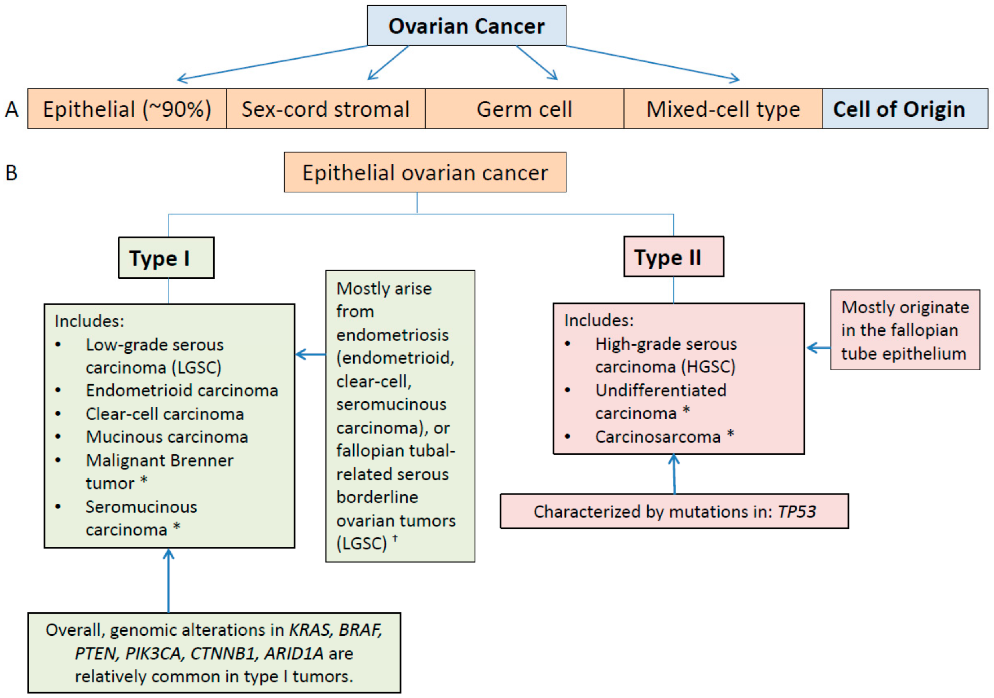

Slide 9
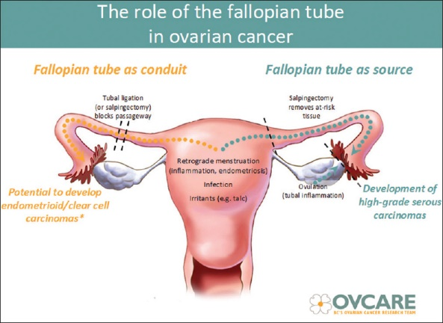

Slide 10
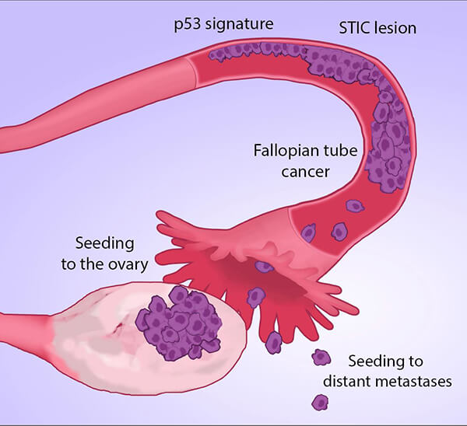
Predisposed To Ovarian Cancer
The last decade has seen mounting evidence in favour of the tubal origin of non-uterine high grade serous cancers (HGSC) especially on the distal and ampullo-fimbrial ends of fallopian
Additionally serous tubal intraepithelial carcinoma(STIC) lesions (preinvasive fallopian tube pathology ) have been identified in tubal mucosa and are thought to be precursors of HGSC
Gene expression and molecular profiling studies demonstrate that ovarian HGSCs more closely resemble fallopian tube epithelium than ovarian surface epithelium.
TP53 (the TP53 tumor suppressor gene ) mutations are extremely common in both STIC lesions and ovarian HGSCs, and more importantly, the particular mutations in these 2 lesions have been shown to be identical.
a decreased risk of ovarian cancer in women who have undergone tubal ligation.

Slide 11
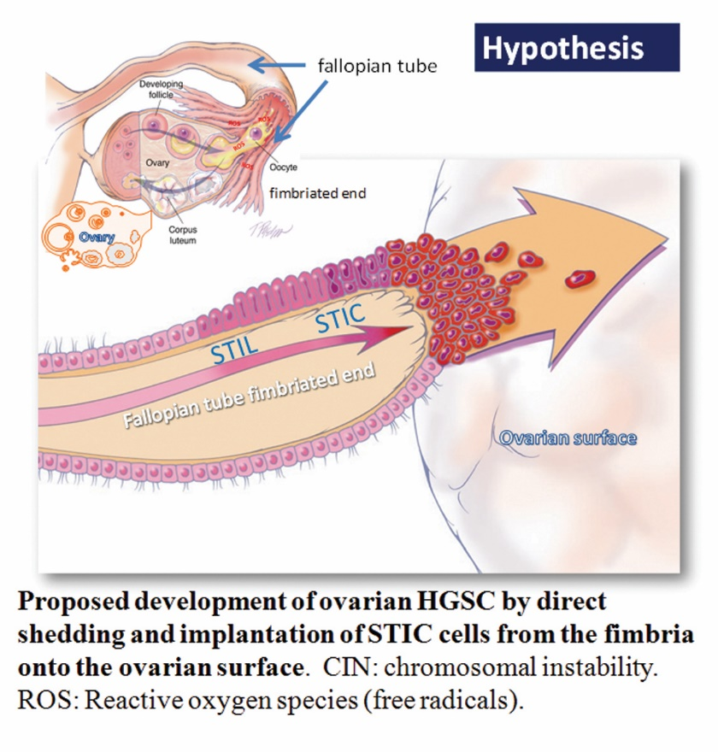
One of the more important finding in last decade of gynecologic oncology is the confirmed theory that types II tumors derive from the epithelium of the Fallopian tube, whereas clear cell and endometrioid tumors derive from endometrial tissue that migrate to the ovary by retrograde menstruation.

Slide 12
High-Grade Serous Carcinoma (HGSC)
It is the most common, accounting for approximately 70 % of invasive ovarian carcinomas
It is usually diagnosed at an advanced stage, and, although it is initially highly responsive to chemotherapy, most women with HGSC ultimately relapse, develop resistance to chemotherapeutic agents and succumb to their disease.

Slide 13
2010 (OVCARE)
In September 2010 the Ovarian Cancer Research team (OVCARE) recommended to all gynecologic surgeons in the province of British Columbia (BC) Canada that, when operating on women at general population risk for ovarian cancer, they should consider:
1) performing bilateral salpingectomy at the time of hysterectomy (even when the ovaries are being preserved); and
2) performing bilateral salpingectomy in place of tubal ligation for sterilization
—herein referred to as opportunistic salpingectomy (OS).
The surgical practice changes were presented as a cancer prevention strategy of unproven efficacy.

Slide 14
In 2011, The Society of Gynecological Oncology of Canada (SGO)
It issued a statement recommending that “physicians discuss the risks and benefits of bilateral salpingectomy with patients undergoing hysterectomy or requesting permanent, irreversible sterilization.”
This practice statement reflects robust histological, immunohistochemical and molecular evidence that most high-grade serous epithelial ovarian cancers (HGSC) in BRCA1/2 + women—and in many women with sporadic, non-hereditary pelvic serous carcinomas—actually originate from the distal portion of the fallopian tube.

Slide 15
SGO statement, 2013
“A paradigm shift in our understanding of pelvic serous carcinomas suggests that the site of origin may be the fallopian tube.
For women at population risk (average) for ovarian cancer, salpingectomy should be considered(after completion of childbearing) at the time of hysterectomy, in lieu of tubal ligation, and also at the time of other pelvic surgery.”

Slide 16
In 2015, the American Congress of Obstetricians and Gynecologists (ACOG)
It started to recommend bilateral salpingectomy as an alternative method for laparoscopic sterilization
At that time, studies of women who were at high risk for ovarian cancer reported that approximately 80% of these malignancies classified as “ovarian” actually originated from the fallopian tube
In fact, serous tubal epithelial carcinoma has been shown to coexist in more than 50% of cases of ovarian cancer, no matter if familial or sporadic in origin [

Slide 17
ACOG Recommendations (2015)
1. The surgeon and patient should discuss the potential benefits of the removal of the fallopian tubes during a hysterectomy in women at population risk of ovarian cancer who are not having an oophorectomy.
2. When counselling women about laparoscopic sterilization methods, clinicians can communicate that bilateral salpingectomy can be considered a method that provides effective contraception.
3. Prophylactic salpingectomy may offer clinicians the opportunity to prevent ovarian cancer in their patients.
4. Randomized controlled trials are needed to support the validity of this approach to reduce the incidence of ovarian cancer.

Slide 18
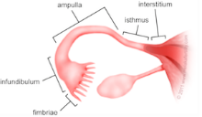
Fallopian Tube
The fallopian tubes consist of four main parts, from medial to lateral:
Intramural (interstitial) part, which is located within the myometrium of the uterus, is 1 cm long and 0.7 mm wide.
The isthmus, which is a lateral continuation of the intramural part. It is a rounded, muscular part of the fallopian tube. It is 3 cm long and between 1 and 5 mm wide.
The ampulla, which is longest part of the tube. It has a diameter of 1 cm at its widest point and is 5 cm long. It has a thin wall, a folded luminal surface and fertilisation usually takes place within its lumen.
The infundibulum, which is the distal end of the tube. It is funnel shaped and opens into the peritoneal cavity at the abdominal ostium. Finger like mucosal projections are attached to the distal end of the infundibulum and are referred to as fimbriae.
-These fimbriae are 1 mm wide and project over the medial surface of the ovaries. The longest of the fimbriae, the ovarian fimbria, attaches to the superior aspect of each ovary

Slide 19
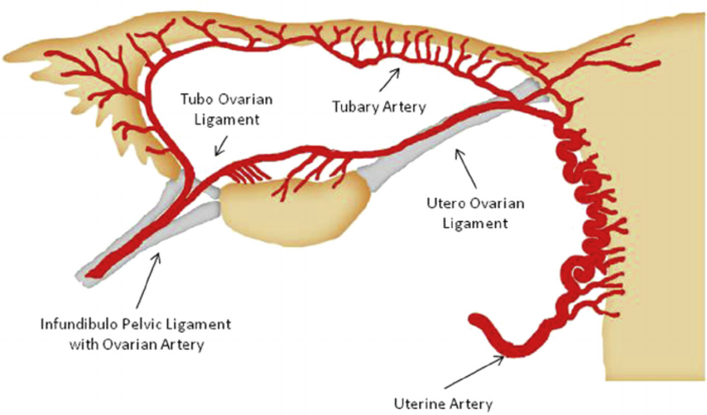
Blood Supply Of The Tube
The principal blood supply of the tube is from the upper end of the uterine artery, which bifurcates and sends a large branch or ramus below the tube to anastomose with the ovarian artery.
The uterine artery supplies the medial two-thirds of the tube, whilst the lateral third is supplied by the ovarian artery.
The arterial supply is quite variable and there may be three branches (medial, intermediate, and lateral) or a branch from the uterine and another from the ovarian artery.
Anastomoses between uterine and ovarian arteries in the mesosalpinx are variable but always present.

Slide 20
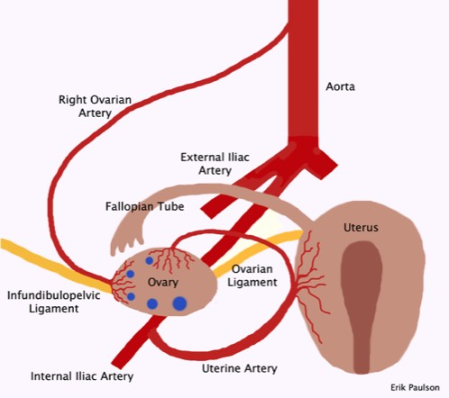
The Ovary
The main arterial supply to the ovary is via the paired ovarian arteries. These arise directly from the abdominal aorta (inferior the renal arteries). There is also a contribution from the uterine arteries.
Venous drainage is achieved by paired ovarian veins. The left ovarian vein drains into the left renal vein, and the right ovarian vein drains directly into the inferior vena cava.
The ovaries receive sympathetic and parasympathetic innervation from the ovarian and uterine (pelvic) plexuses, respectively. The nerves reach the ovaries via the suspensory ligament of the ovary, to enter the ovary at the hilum
The main blood supply is from the ovarian artery. The second source of arterial blood comes from a collateral uterine artery.

Slide 21
Definition
Salpingectomy is the process of surgically removing one or both of the fallopian tubes
while
leaving the uterus and ovaries intact

Slide 22
Types Of Salpingectomy
Complete
Partial
Tubal ligation
Excision as ttt of ectopic

Slide 23
Types Of Tubal Ligation (Female Sterlisation)
Bipolar coagulation The most popular method of laparoscopic female sterilization, this method uses electric current to cauterize sections of the fallopian tube.
Monopolar coagulation Less common than bipolar coagulation, monopolar coagulation uses electric current to cauterize the tube together, but also allows radiating current to further damage the tubes as it spreads from the coagulation site. Many cases involve a cutting of the tubes after the procedure.[Fimbriectomy By removing a portion of the fallopian tube closest to the ovary, fimbriectomy eliminates the fallopian tube's ability to capture eggs and transfer them to the uterus
Irving's procedure This procedure calls for placing two ligatures (sutures) around the fallopian tube and removing the segment of tubing between the ligatures. Then to complete the procedure, the ends of the fallopian tubes are connected to the back of the uterus and the connective tissue respectively This method was pioneered by the American Obstetrician-Surgeon, Frederick Carpenter Irving (1883–1957) in 1924
Tubal clip The tubal clip (Filshie clip or Hulka clip) technique involves the application of a permanent clip onto the fallopian tube. Once applied and fastened, the clip disallows movement of eggs from the ovary to the uterus.]
Tubal ring The silastic band or tubal ring method involves a doubling over of the fallopian tubes and application of a silastic band to the tube.[
Pomeroy tubal ligation In this method of tubal ligation, a loop of tube is “strangled” with a suture. Usually, the loop is cut and the ends cauterized or “burned“. This type of tubal ligation is often referred to as cut, tied, and burned This method was develop by the American Gynecologist and Surgeon, Ralph Hayward Pomeroy.
Essure tubal ligation In this method of tubal ligation, two small metal and fiber coils are placed in the fallopian tubes. After insertion, scar tissue forms around the coils, blocking off the fallopian tubes and preventing sperm from reaching the egg.
Adiana tubal ligation In this method of tubal ligation, two small silicone pieces are placed in the fallopian tubes. During the procedure, the health care provider heats a small portion of each fallopian tube and then inserts a tiny piece of silicone into each tube. After the procedure, scar tissue forms around the silicone inserts, blocking off the fallopian tubes and preventing sperm from reaching the egg. This procedure can no longer be performed due to a lawsuit and judgment brought by the company responsible for Essure.

Slide 24
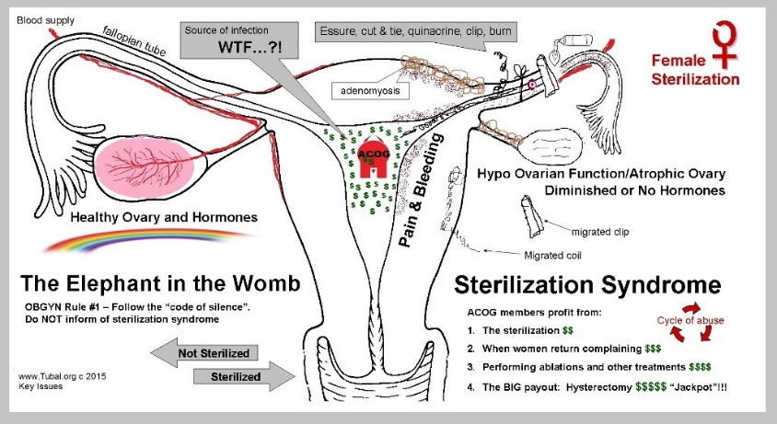
Bilateral Tubal Ligation is not without risks
The modified Pomeroy technique is the most common postpartum sterilization method performed in the United States, with a 10 year failure rate of < 1%
Hydrosalpinx, torsion, and tubal pregnancy are all potential complications of tubal ligation, which often require an additional procedure

Slide 25
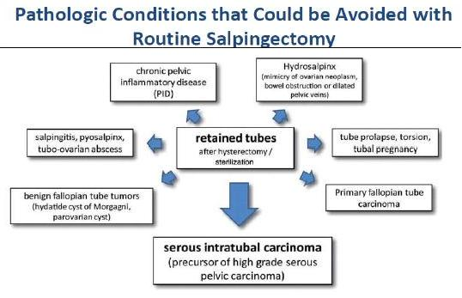
Leaving Tubes After Hysterectomy is not without risks

Slide 26
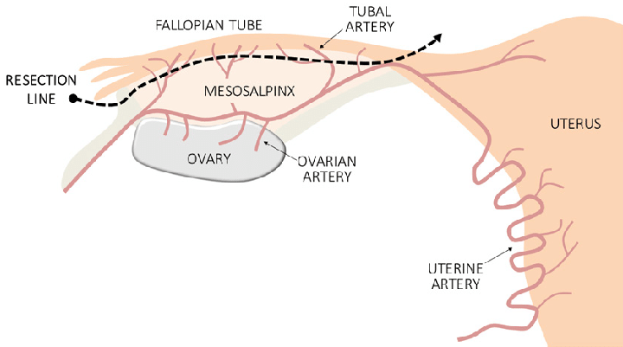
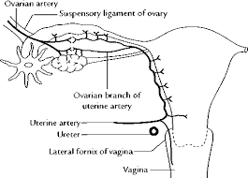
Technique of Complete Salpingectomy
Total ( especially all the fimbria)
Cauterize/ remove any fimbrial attachment on the ovary
Remove completely from fimbrial end up to utero-tubal junction
Stay as close as possible of the tube (to respect Ovarian Blood supply)

Slide 27
How is the Procedure Performed?
There are several techniques to perform salpingectomy, but the most common and preferred method is laparoscopy
Some surgeons prefer to do away with a viewing instrument and would make an incision in the lower abdomen to remove the tube instead. This process is termed minilaparotomy.
A more invasive approach is termed laparotomy and requires the surgeon to make a large incision in the lower abdomen to allow a better exploration of the abdomen area. This approach is especially considered if there is a need to remove both fallopian tubes.
In rare cases, salpingectomy is performed through a surgical incision in the vagina, termed colpotomy. In this method, the affected fallopian tube is approached through the vagina.

Slide 28
Laparoscopy
Both traditional and robotic approaches to laparoscopy allow for bilateral salpingectomy at the time of hysterectomy.
A grasper should be used to hold onto the infundibular portion of the fallopian tube and to provide gentle traction toward the anterior abdominal wall. This allows for better exposure and visualization of the plane between the ovary and fallopian tube.
Any laparoscopic instrument that allows for electrosurgical vessel sealing and transection of tissue can be used to dissect across the mesosalpinx.
Alternatively, a monopolar electrosurgery device can be used to cauterize the mesosalpinx before transection with endoscopic scissors. Again, transect the mesosalpinx as close to the fallopian tube as possible while ensuring that the tube is entirely removed.
As in the open approach, the fallopian tubes can be left attached to the uterus while the hysterectomy is performed and removed as a single unit once the hysterectomy is complete.

Slide 29
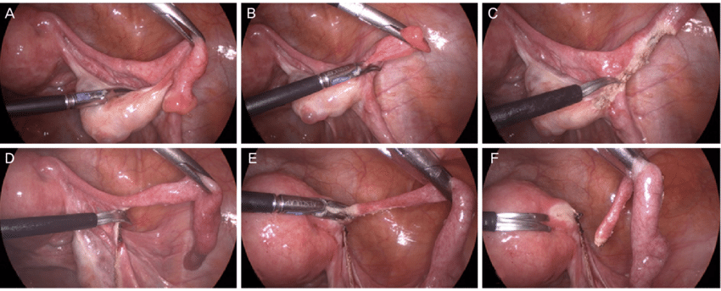
Laparoscopic salpingectomy
Fallopian tubes are resected from the fimbrial end to the uterine cornu. Careful resection is performed at the posterior margin of the fallopian tubes, while conserving the mesosalpinx.

Slide 30
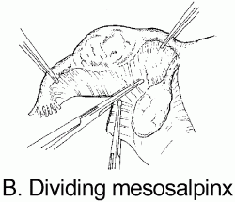
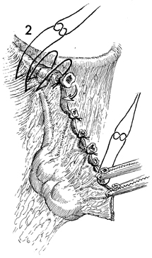
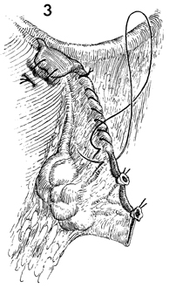
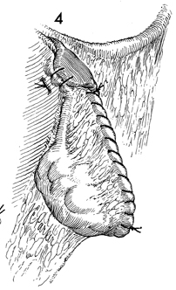
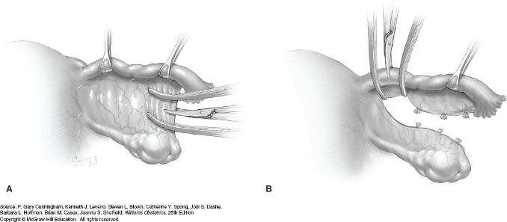
Laparotomy
In general, we recommend that salpingectomy at the time of abdominal hysterectomy be performed prior to hysterectomy because it allows for complete removal of the entire fallopian tube without the need to re-isolate any surgical pedicle.
The ampullary portion of the fallopian tube is grasped with a Babcock clamp and elevated.
Fenestrations should be made within the mesosalpinx, isolating the small vessels that lie between the ovary and fallopian tube. These vessels are branches of the ovarian and uterine arteries and may provide additional blood supply to the ovaries. Small clamps, such as Kelly or tonsil clamps, are placed across these vessels, favoring the tubal side of the mesosalpinx, in order to preserve as much ovarian blood supply as possible. Each pedicle is then transected and ligated.
Alternatively, a monopolar electrosurgery device with coagulation current or an electrosurgical vessel sealing device can be used. These devices should be placed immediately adjacent to the tube in order to cauterize and transect the mesosalpinx.
Be sure to incorporate the entire fimbriated distal portion of the tube, which sometimes requires careful dissection of tubal adhesions or distal tubal cysts off the ovary and its blood supply. At the cornual segment of the fallopian tube, take care to avoid entry into the uterine myometrium, as this region can be particularly vascular.
Once detached from the mesosalpinx, the fallopian tubes can be left attached to the uterus as the hysterectomy is then performed and can be removed en bloc with the uterus.

Slide 31
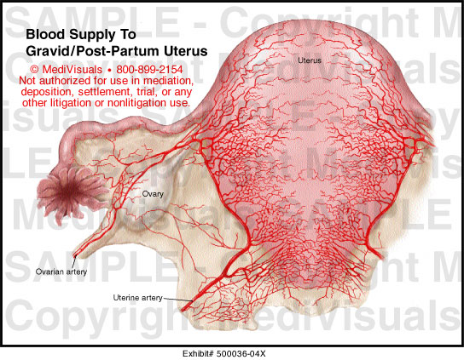
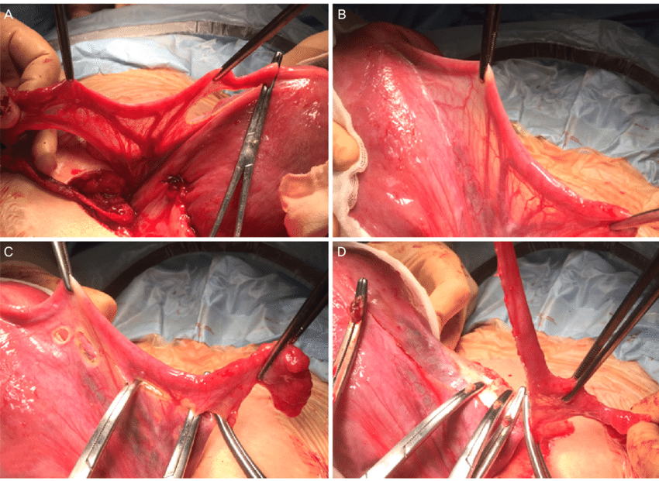
Salpingectomy during cesarean delivery
(A, B) The engorged vessels in the mesosalpinx and the broad ligament during pregnancy;
(C) resection of the tubo-ovarian ligament and mesosalpinx as close as possible to the fallopian tube, with ligation of engorged tubal vessels; and
(D) resection of the fallopian tube at the uterine cornu.

Slide 32
LIGASURE Electricity for bilateral salpingectomy at the time of Cesarean delivery
LIGASURE Electricity based cautery tool used during both laparoscopic and open surgery for optimal hemostasis
Procedure: Clamping and suturing Step by step clamping and suturing of the mesosalpinx until achievement of total salpingectomy.

Slide 33
Vaginal Salpingectomy
At the time of vaginal hysterectomy is often the most challenging of these procedures. In this situation, the hysterectomy is performed as usual up to the level of the “triple pedicles.” At that point, the first triple pedicle—incorporating the utero-ovarian ligaments, the fallopian tubes, and the round ligaments—is clamped and transected from the uterus. A large clamp, such as a Zeppelin, Heaney, or long Pean, should be used. Then place gentle upward traction on the uterus to keep the operative field clear of intraperitoneal contents.
Next evaluate the feasibility of transvaginal salpingectomy by gently turning the clamp on the triple pedicle in order to make an anatomic assessment. In a technique described by Kho and colleagues, the round ligament can first be divided to allow better mobilization of the adnexa and access to the proximal fallopian tube.27 The challenge from this point is to incorporate the entire fallopian tube into the salpingectomy specimen. Leaving the triple pedicle clamped rather than suture-ligating it allows for the clamp to become a handle with which gentle traction and manipulation of the tube can be performed.
Once identified, the fimbriated end of the fallopian tube should be brought into the operative field with a Babcock clamp. Transection of the mesosalpinx begins with freeing the fimbriated end from the ovary. Again, this can be done by clamping, transecting, and ligating isolated vascular pedicles of the mesosalpinx, or with monopolar cautery or an electrosurgical vessel sealing device. In our experience, an electrosurgical vessel sealing device allows for more dexterity and easier sealing and transection of the mesosalpinx during vaginal surgery than individually clamping, cutting, and ligating each pedicle. Once the isthmic portion of the tube is reached, place a second large clamp just cephalad to the large clamp that contains the triple pedicle. This second clamp should incorporate only the utero-ovarian ligament and the round ligament, leaving the fallopian tube free. The first large clamp can then be removed, allowing for completion of the salpingectomy while the utero-ovarian ligament and the round ligament remain clamped at all times. Then remove the fallopian tube in its entirety. Clamp and transect the contralateral triple pedicle, and remove the uterus before performing contralateral salpingectomy. A surgical sponge on a Forester clamp can be used to gently push the intraperitoneal contents out of the operative field. Complete the contralateral salpingectomy in a similar fashion after removing the uterus. Summary Salpingectomy at the time of hysterectomy with ovarian preservation will likely become more common as growing evidence implicates the fallopian tube as the site of origin of high-grade serous ovarian cancer. Operative considerations include removal of the fallopian tube in its entirety and preservation of ovarian blood supply. The techniques described here allow for removal of the fallopian tubes while respecting these considerations.

Slide 34
Operating Time
Minimal additional time
Hysterectomy + 16 Min
Sterilization + 10 Min

Slide 35
Possible Risks and Complications Of Salpingectomy
Excessive bleeding is another risk, which is possible during and after the procedure.
There is also the possibility of damaging surrounding parts like the uterus, ovaries, blood vessels, and nerves. In rare cases, the bowels may also be injured or damaged, resulting in the need for additional surgical interventions.
Another possible complication is intestinal blockage, leading to stomach cramps, bloating, and repeated burping.
Pain in the surgical site is also expected, though it is usually manageable and disappears after a few weeks.
Scar formation is expected, both internally and externally.

Slide 36
Ovarian function before and after salpingectomy
The long-term impact of salpingectomy on ovarian function, such as timing of menopause, is an important concern. It has been shown (Siddle et al., 1987) that the mean age of ovarian failure was lower in women who had undergone hysterectomy. However, salpingectomy and hysterectomy are scarcely comparable since the latter is far more devastating to the ovarian nerve and blood supply than the laparoscopic procedure. Furthermore, the local hypertension that results from the occlusion of the ovarian ligament may have a role in deterioration of ovarian function.
The hypothesis that removal of both uterus and fallopian tubes causes a redistribution of the blood flow in favor of the ovaries. Moreover, hormone production by the ovaries was also found to be unaffected even months after the intervention
However,
the long-term effects of premature menopause on mortality and morbidity are largely unknown, and concerns regarding these effects have led to discussion of a staged approach of initial bilateral salpingectomy once childbearing is complete, followed by an oophorectomy closer to natural menopause

Slide 37
No Short-term Negative Effects on Ovarian Reserve
Simultaneous salpingectomy performed at the time of hysterectomy has no short-term negative effects on ovarian reserve.
To add plausibility to this finding, we would like to point to the vascular connections: In the ovaries, blood supply is secured mainly via the arteria ovarica from the aorta and the ramus ovaricus from the arteria uterina. These two arteries naturally anastomose with each other. A further branch of the arteria uterina, the ramus tubarius, connects the fallopian tube. During hysterectomy, the arteria uterina is ligated. Nevertheless, the central branch of the arteria ovarica in the infundibulopelvic ligament still guarantees sufficient blood flow from the aorta to the ovaries. A collateral connection of the remaining branch of the ramus tubarius from the anastomosis with the arteria ovarica also secures the vascular supply of the fallopian tube. However, when salpingectomy is performed concomitant with hysterectomy, the ramus tubarius will be removed. Accordingly, all the blood passing through the ligamentum infundibulo pelvicum will now become available to the ovaries. Blood circulation through the ovaries should therefore remain unaffected or even increase when hysterectomy is combined with salpingectomy

Slide 38
the 50 % reduction in breast cancer incidence associated with premenopausal RRBSO in high-risk women would also need to be considered in these prospective studies before changing clinical practice for ovarian cancer prevention among BRCA1/2 mutation carriers.

Slide 39
Time Of Prophylactic
= opportuinistic salpingectomy with CS or hysterectomy or other pelvic operations
= plannaed risk-reducing salpingectomy
- family history – bilateral salpingectomy or salpingo-oophorectomy -- early age of onset of
ovarian cancer in the family
-Gene mutation -At age 35–40 for BRCA1 carriers or
-At age 40–45 for BRCA2
bilateral salpingo-oophorectomy upon completion of child-bearing

Slide 40
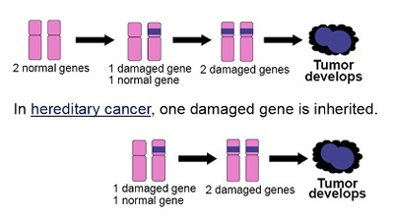
BRCA gene (BReast CAncer gene)
BRCA1 and BRCA2 are human genes that produce tumor suppressor proteins. These proteins help repair damaged DNA and, therefore, play a role in ensuring the stability of each cell’s genetic material. When either of these genes is mutated, or altered, such that its protein product is not made or does not function correctly, DNA damage may not be repaired properly. As a result, cells are more likely to develop additional genetic alterations that can lead to cancer.
Specific inherited mutations in BRCA1 and BRCA2 most notably increase the risk of female breast and ovarian cancers, but they have also been associated with increased risks of several additional types of cancer. People who have inherited mutations in BRCA1 and BRCA2 tend to develop breast and ovarian cancers at younger ages than people who do not have these mutations
The BRCA gene test is a blood test that uses DNA analysis to identify harmful changes (mutations) in either one of the two breast cancer susceptibility genes — BRCA1 and BRCA2.
Women who have inherited mutations in these genes are at an increased risk of developing breast cancer and ovarian cancer compared with the general population.

Slide 41
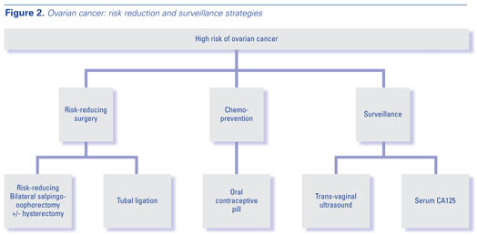
For high-risk patients without an identified genetic mutation, a thorough family history and risk stratification can be performed to estimate their cancer risks and clinical judgment can be used to guide screening and preventive measures.

Slide 42
Recommendations
1. The use of an oral contraceptive pill reduces the risk of users developing high-grade serous cancers and should be discussed when counselling women on contraceptive use (Strong, High).
2. When considering permanent contraception, tubal ligation is shown to have the additional benefit of reducing the risk of developing highgrade serous cancers. However, the fact that the complete removal of the fallopian tube may provide additional benefit should be discussed (Strong, High).
3. Removal of the ovaries in premenopausal women may increase the risk of cardiovascular disease and is not recommended without clinical indication (Strong, High).
4. Population-based screening should not be encouraged as a method of “ovarian” cancer risk reduction (Strong, High).
5. In considering hysterectomy with the ovaries remaining in situ, the fact that the removal of easil accessible fallopian tubes may reduce the risk of developing high-grade serous cancers without additional procedural risk, and is recommended, should be discussed (Strong, Moderate).
6. Prospective population-based surgical databases should be kept to monitor the effect of opportunistic salpingectomy on overall morbidity and mortality and especially the rates of high-grade serous cancers (Strong, Moderate).

Slide 43
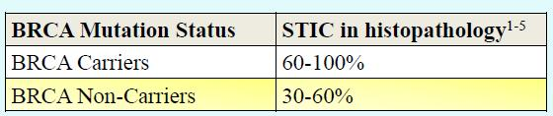
Low risk cancer ( not carrying BRCA mutations or no family history ). ----opportunistic bilateral salpingectomy Bilateral salpingectomy with ovarian retention (BSOR), including Cs , sterlisation and other pelvic operations eg hysterectomy , myomectomy and treatment of endometriosis, in whom fertility is no longer desired or fallopian tubes are damaged
Moderate risk cancer : family history –risk reducing bilateral salpingectomy or Risk reducing Salpingectomy-delayed oophorectomy
High risk cancer (carrying BRCA mutations).
Risk reducing Salpingectomy-delayed oophorectomy
or
- salpingo-oopherectomy

Slide 44
 | Average Risk | Slightly Increased Risk | Moderately Increased Risk | Very Increased Risk
age |  | +
wt |  | +
Infertility history |  | +
Fertility drugs |  | +
Endometriosis |  | +
HRT postmenopause |  | +
Family history |  |  | + Women with a mother, sister, grandmother or aunt who has had ovarian cancer
Genetic BRCA1,2,others |  |  |  | +
 | Opportunistic bilateral salpingectomy =during sterilisation =during CS =during hysterectomy =during any gynecologic operations |  | =TVU and the CA-125 blood test two times per year = chemoprevention – oral contraceptive pills (cop,pop) = risk reducing bilateral salpingectomy +oopherectomy on early age of onset of ovarian cancer in the family | TVU and the CA-125 blood test two times per year starting at age 30–35 until the ovaries and fallopian tubes are removed preventively =once child-bearing is complete Risk-reducing bilateral salpingo-oophorectomy (RRBSO) at age 35–40 for BRCA1 carriers or At age 40–45 for BRCA2
 |  |  |  | a staged approach of initial bilateral salpingectomy once childbearing is complete (reduce ovarian cancer), followed by bilateral oophorectomy closer to natural menopause(reduce breast cancer)

